Slide 1
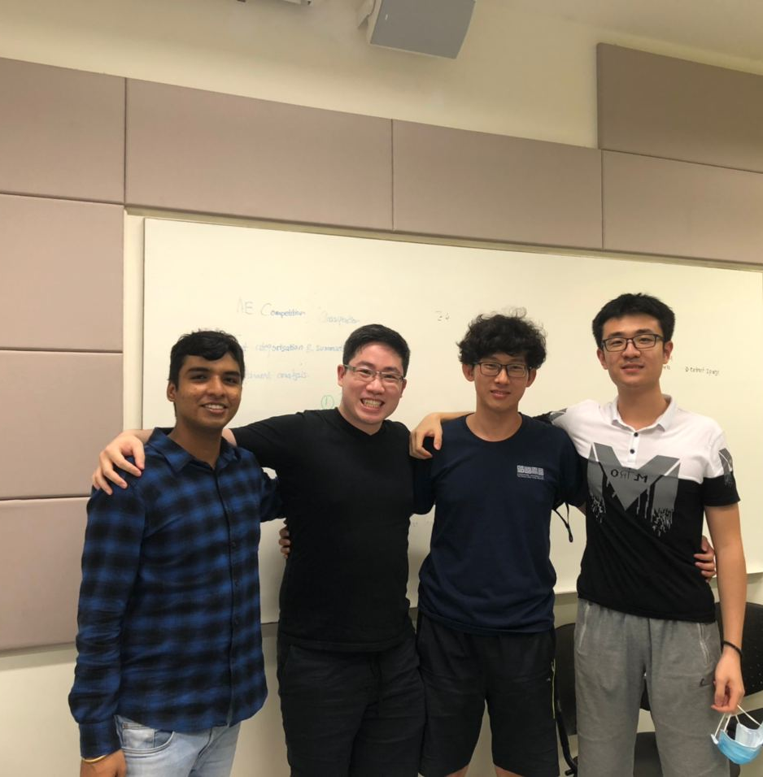
Too much study Too little room
40.015: Simulation Modeling and Analysis
Collaborators :
Chi Ziheng
Wu Qi
Ryan Wong Jun Wei
Sabari Ganesan
Date: 11/12/2020

